Slide 1
Computer Networks
Homework 1 Q&A

Slide 2
Assignment
Part1:1-3 Dou, Xianzheng E-mail: dozenow@163.com
Part1:4-5 Wang, Peng E-mail: peng_wp@163.com
Part2:1-3 Qiu, Shuang E-mail: qshhnkf@gmail.com
Part2:4-6 Wu, Jiewei E-mail: wujayway@gmail.com

Slide 3
Part 1
Consider sending real-time voice from Host A to Host B over a packet-switched network (VoIP). Host A converts analog voice to a digital 64kbps bit stream on the fly. Host A then groups the bits into 56-byte packets. There is only one link between Host A and B; its transmission rate is 500 kbps and its propagation delay is 2 msec. As soon as Host A gather a packet, it sends it to Host B. As soon as Host B receives an entire packet, it converts the packet's bits into an analog signal. How much time elapses from the time a bit is created (from the original analog signal at Host A) until the bit is decoded (as part of the analog signal at Host B)?

Slide 4
Part1(cont.)
Solution:
Since Host A converts analog voice to a digital 64kbps bit stream on the fly, we assume the converting rate(both encoding and decoding) is the same as bit-rate of the encoded code.
Time to encode/decode the bit stream of a packet: 56*8/64K = 7ms
Time to transmit packet: 56*8/500K = 0.896ms
Time to propagate: 2ms
Total time elapses from a bit created until the bit decoded is:
7 + 0.896 + 2 = 9.896ms

Slide 5
Part1(cont.)
NO COPY IS ALLOWED!!!
FAQ
Should we take the decoding time into consideration? Thus extra 7ms for signal decoding is required.
Given another 7ms for signal decoding, should we also double the transmit time – one for sending, the other for receiving?
Please refer to
Textbook: Delay and Loss in Packet-Switched Networks/Types of Delay
http://stackoverflow.com/questions/5660430/working-out-transfer-speed

Slide 6
Part1(cont.)
Try to identify at least 3 applications that use plaint text password/identification method. Use Wireshark to capture the plaint text password and write a report to describe how and where you found the passwords. You need to turnin packet dumps for this problem.
Elearning
Renren
HaoFang
Etc.

Slide 7

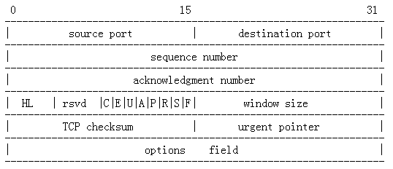
Part1(cont.)
How to filter packets

Slide 8
Part1(cont.)
Please refer to
http://wiki.wireshark.org/CaptureFilters
http://peng-wp.iteye.com/blog/1222521

Slide 9
Part2
Ifconfig
Run ``ifconfig -a'' on the machine you will be using. Capture the output, and identify and explain as much of what is printed as you can. NOTE: You should be able to understand almost all of it.
Memory: 80200000-80220000
Address of memory mapping
That means the NIC’s onboard memory are mapped into memory so the CPU can copy data into and out of them as the card sends and receives packets.

Slide 10
Part2(cont.)
ARP
You still have the ability to modify the ARP table, just not directly. How can you affect (either add, delete, or change) entries in the ARP table? Use this mechanism to add at least two new hosts to the ARP table and include a printout.
Use ping or other network utilities to try to communicate with an unknown host can indirectly insert an ARP entry into the table.

Slide 11
Part2(cont.)
ARP
What will happen if two IP addresses map to the same Ethernet address? Be specific on how all hosts on the subnet operate.
FAQ
Answer is not clear.
A simple “Yes/No” is far from enough.
Note “ALL HOSTS” highlighted. You should specify explicitly how the victim machines will operate and what’s the behavior of others.

Slide 12
Thanks
Feel free to contact any of us if any problem.

